Slide 1
CIS8695: Managing Big Data Analytics
Nasim Mousavi
Assistant Professor
J. Mack Robinson College of Business
Georgia State University
nmousavi@gsu.edu

Slide 2
Linear Regression

Slide 3
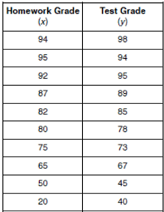
Regression Analysis
Estimate a relationship between variables
Example: Relationship between test grade based on homework grade

Slide 4
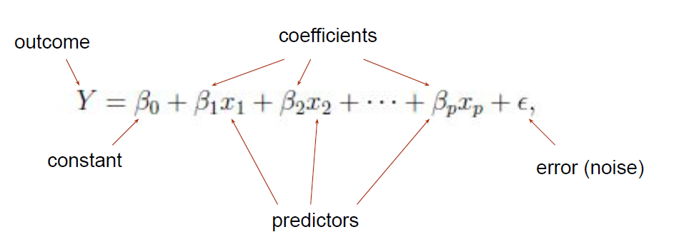
Regression Analysis
Relationship between a continuous dependent (outcome) variable and independent (predictor) variables
Linear regression assumes a linear relationship between independent variables and a continuous dependent variable

Slide 5
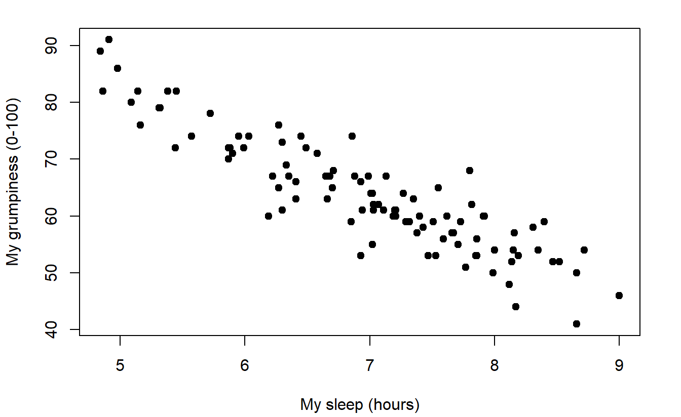
Regression Analysis
Relationship between my grumpiness and my sleep hours

Slide 6
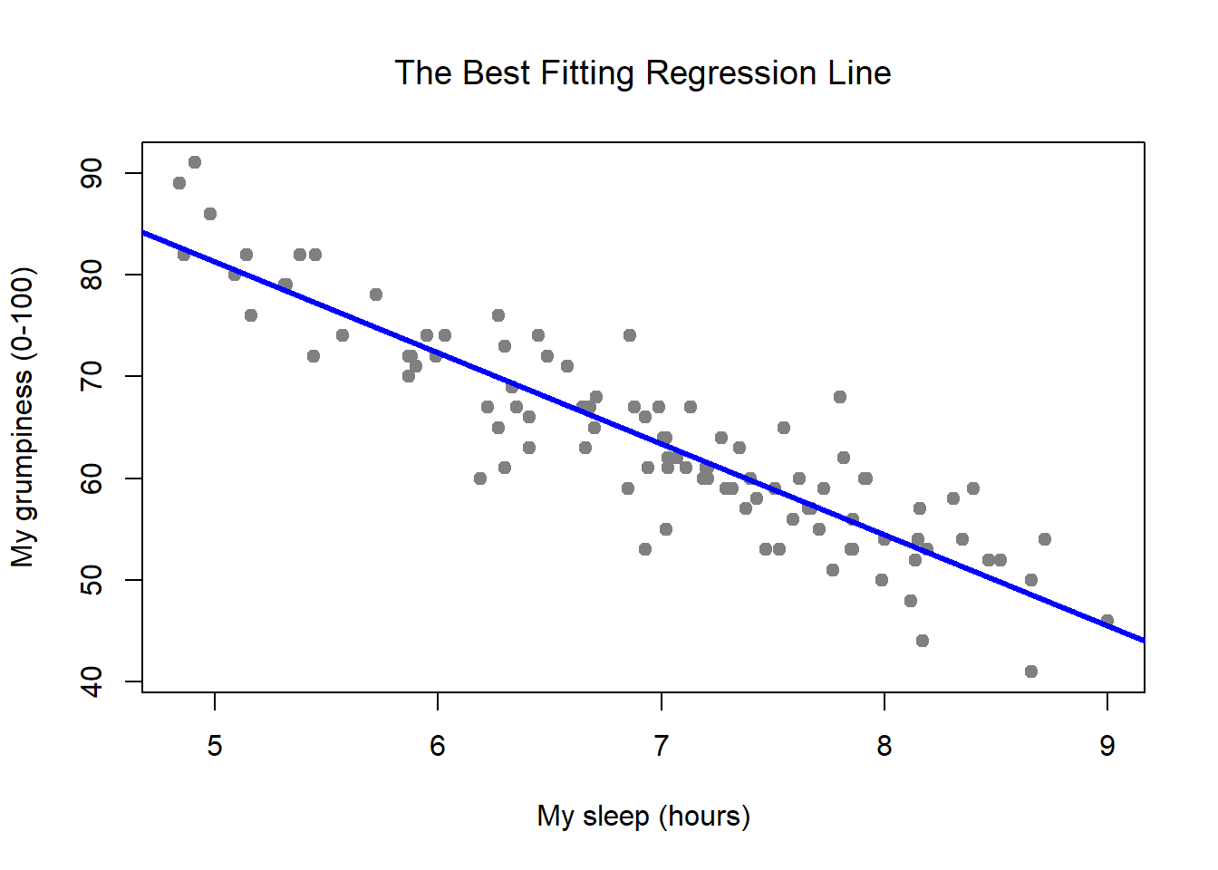
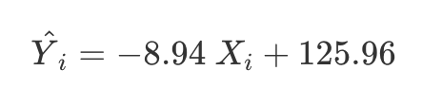
Regression Analysis
The regression line is the straight line best fit to the data

Slide 7
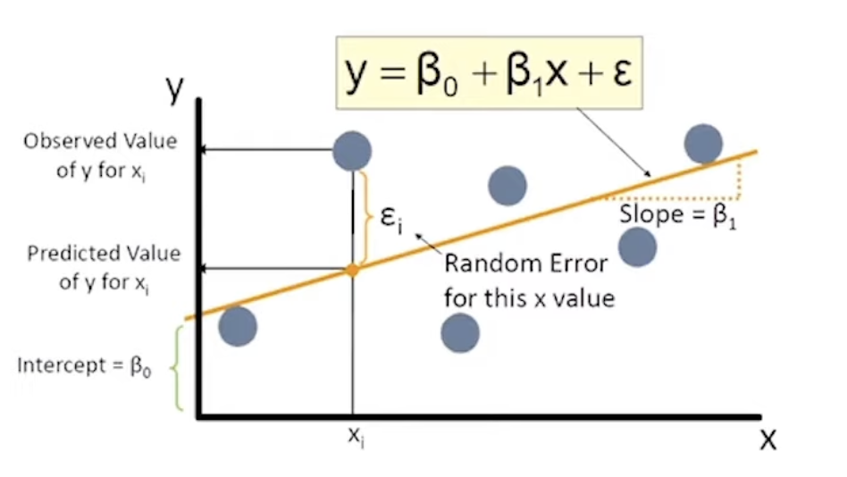
Regression Analysis

Slide 8

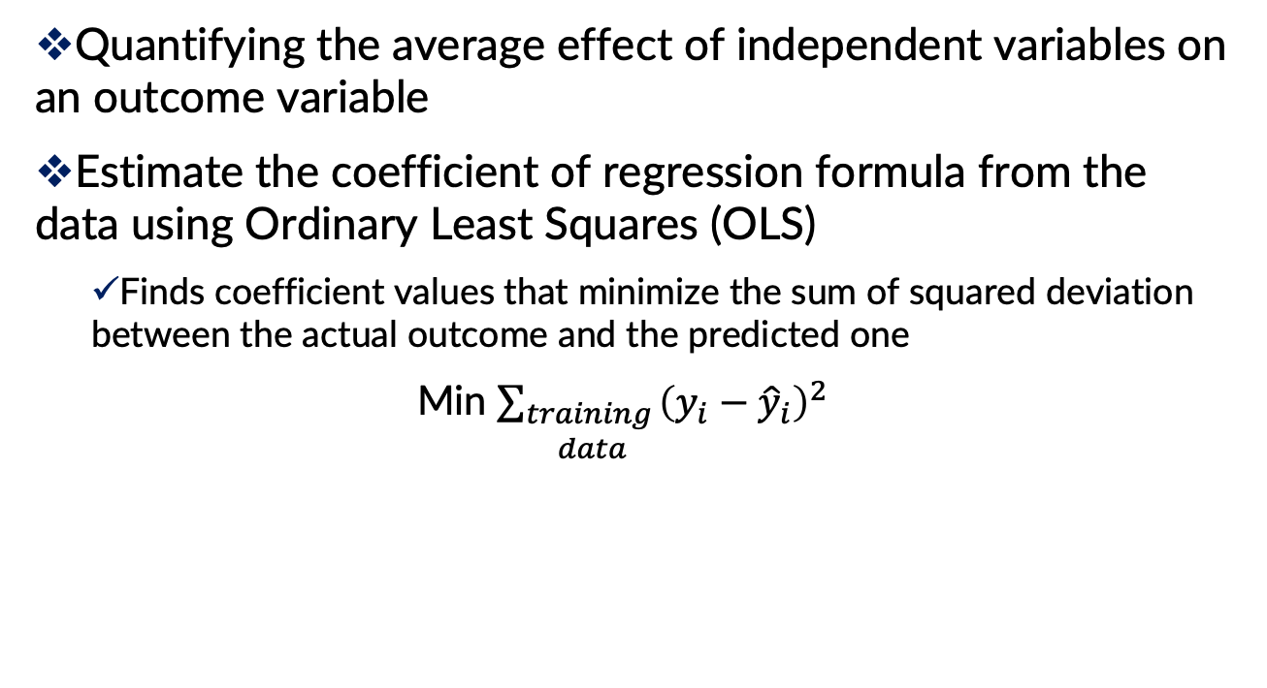
Regression Analysis
Quantifying the average effect of independent variables on an outcome variable
Estimate the coefficient of regression formula from the data using Ordinary Least Squares (OLS)
Finds coefficient values that minimize the sum of squared deviation between the actual outcome and the predicted one
Min $\sum_{\begin{aligned}training \\ data\end{aligned}}{{\left(y_{i}−{\hat{y}}_{i}\right)}^{2}}$

Slide 9
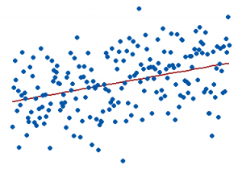
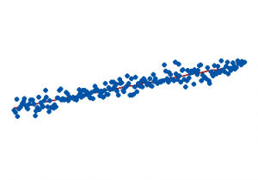

Regression Analysis
How well the line fit the data: measured by $R^{2}$
The proportion of variance in the dependent variable that can be explained by independent variables
R2 = 15%
R2 = 85%

Slide 10
Regression Analysis: Prediction
Regression model can also be used as a prediction model to predict the dependent variable for a new observation
Instead of focusing on coefficient and goodness of fit (R2), the focus is on predicted value and predictive accuracy
Need training & test sets
Training set is used to estimate the mode
Test set is used to assess model’s predictive performance

Slide 11
Example

Slide 12
Problem: Prices of Toyota Corolla
A large Toyota car dealership offers new car buyers the option to buy new cars as part of a trade-in their used cars
The dealer needs to predict the price for the used cars, to ensure a reasonable profit
Data were collected on all previous sales of used Toyota Corollas

Slide 13
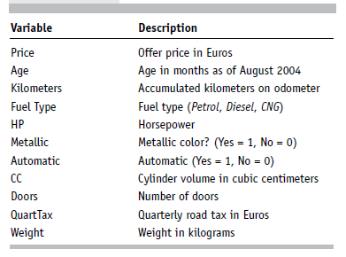
Problem: Prices of Toyota Corolla
Data: 1000 used Toyota Corollas, with their specification information

Slide 14
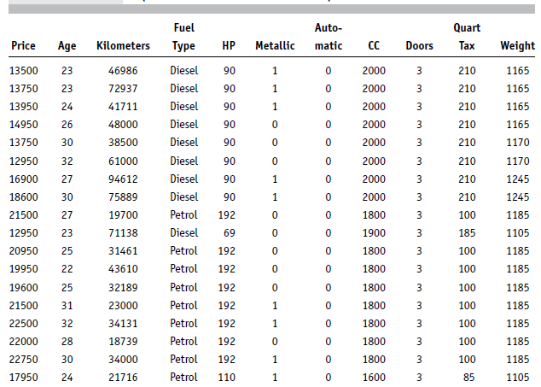
Problem: Prices of Toyota Corolla

Slide 15
Data Preprocessing
Fuel type is categorical, must be transformed into binary variables
Has three categories, so use two dummies:
Fuel_Type_Diesel (0/1), Fuel_Type_CNG (0/1)
No dummy needed for “Petrol” (reference category)
Data partition (training 60% validation 40%)

Slide 16
Data Preprocessing
Reduce data frame to the top 1000 rows and select columns for regression analysis
- car_df = pd.read_csv('ToyotaCorolla.csv’)
- car_df = car_df.iloc[0:1000]
- predictors = ['Age_08_04', 'KM', 'Fuel_Type', 'HP', 'Met_Color',
'Automatic', 'CC', 'Doors', 'Quarterly_Tax', 'Weight’]
- outcome = 'Price’

Slide 17
Data Preprocessing
Partition data to train and test
- X = pd.get_dummies(car_df[predictors], drop_first=True)
- y = car_df[outcome]
- train_X, valid_X, train_y, valid_y = train_test_split(X, y, test_size=0.4, random_state=1)
- car_lm = LinearRegression()
- car_lm.fit (train_X, train_y)

Slide 18
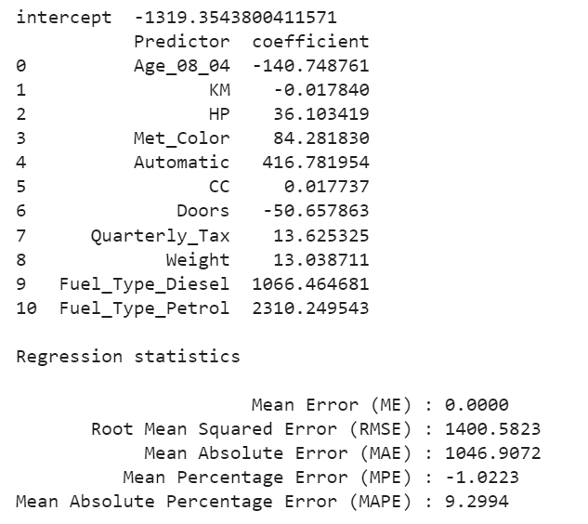
The Fitted Regression Model on Training

Slide 19
The Fitted Regression Model on Training
What does the coefficient tell us? (like weight)
As the value of the Weight increases in one unit, holding others constant, the mean of the dependent variable increases by 13 units

Slide 20
Predictions for the Validation Data
Use predict() to make predictions on a new set
- car_lm_pred = car_lm.predict(valid_X)
- result = pd.DataFrame({'Predicted': car_lm_pred, 'Actual': valid_y, ‘Residual': valid_y - car_lm_pred})
- print(result.head(20))

Slide 21
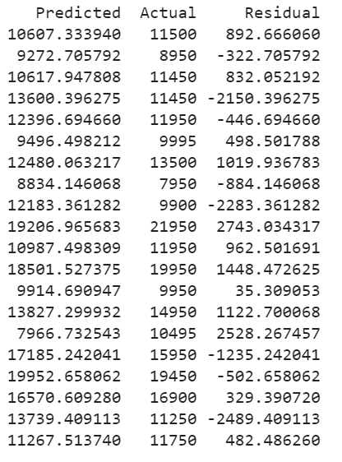
Predictions for the Validation Data
Predicted price computed using regression coefficients
Residuals = difference between actual and predicted prices

Slide 22
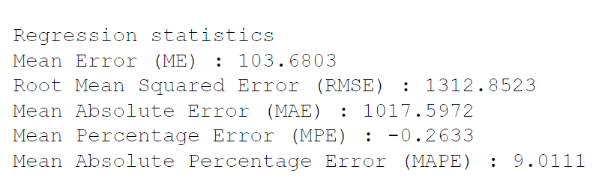
How Well did the Model Do With the Validation Data?
Print performance measures (validation data)
- regressionSummary (valid_y, car_lm_pred)

Slide 23
Variable Selection

Slide 24
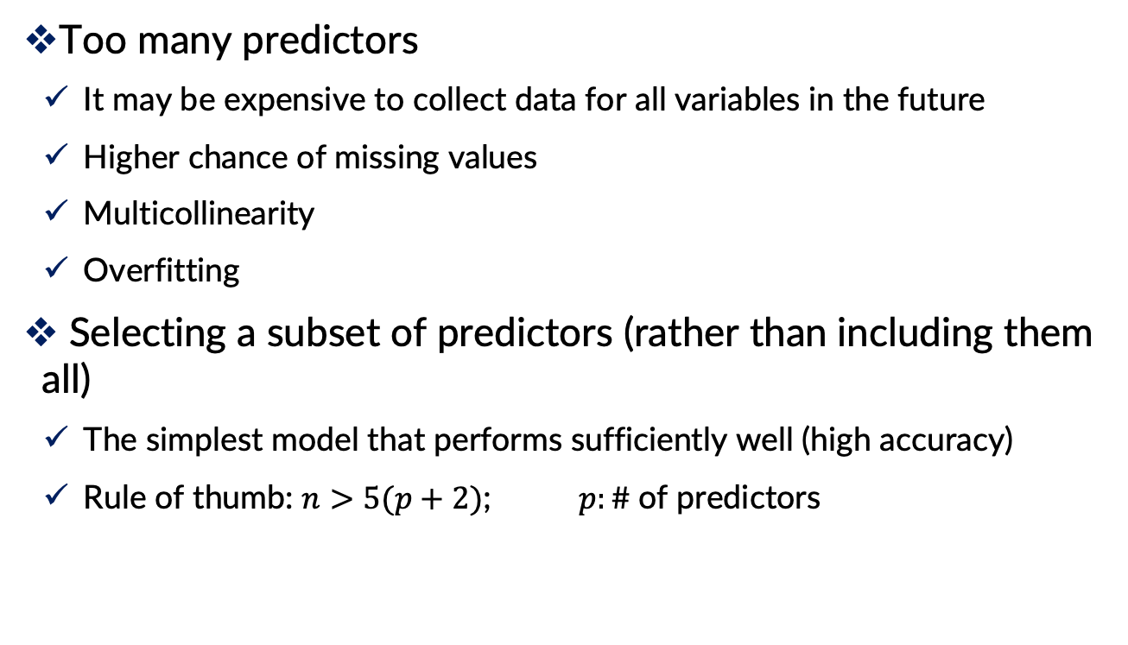
Why Variable Selection?
Too many predictors
It may be expensive to collect data for all variables in the future
Higher chance of missing values
Multicollinearity
Overfitting
Selecting a subset of predictors (rather than including them all)
The simplest model that performs sufficiently well (high accuracy)
Rule of thumb: $n>5(p+2)$; $p:\#$of predictors

Slide 25
How to Select Variables? Basic Methods
The first step is using domain knowledge to select the relevant predictors
Summary statistics and graphs
Correlation tables, missing value counts
To detect variables highly correlated or with high level of missing values

Slide 26
How to Select Variables? Exhaustive Search
All possible subsets of predictors assessed (single, pairs, triplets, etc.)
Select a subset that not too simplistic (underfit) and not overly complex (overfit)

Slide 27

Criterion to Select the best Subset
Judge by “adjusted R²”
$R^{2}$: Proportion of explained variability in the model
$n$= Number of predictors
$p=$Penalty on the number of predictors
Models with higher adjusted R² is better

Slide 28
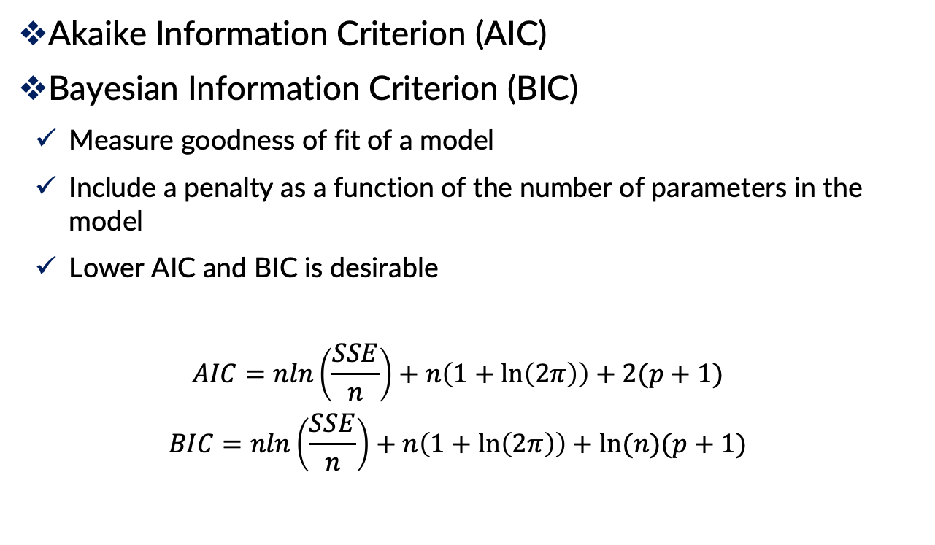
Criterion to Select the best Subset
Akaike Information Criterion (AIC)
Bayesian Information Criterion (BIC)
Measure goodness of fit of a model
Include a penalty as a function of the number of parameters in the model
Lower AIC and BIC is desirable
$$AIC=nln\left(\frac{SSE}{n}\right)+n\left(1+\ln\left(2π\right)\right)+2(p+1)$$
$$BIC=nln\left(\frac{SSE}{n}\right)+n\left(1+\ln\left(2π\right)\right)+ln⁡(n)(p+1)$$

Slide 29
How to Select Variables? Model-Based
Iterative search through the space of all possible regression models
Deliver one best subset of predictors
Popular variable selection algorithms
Forward Selection
Backward Elimination
Stepwise Regression

Slide 30
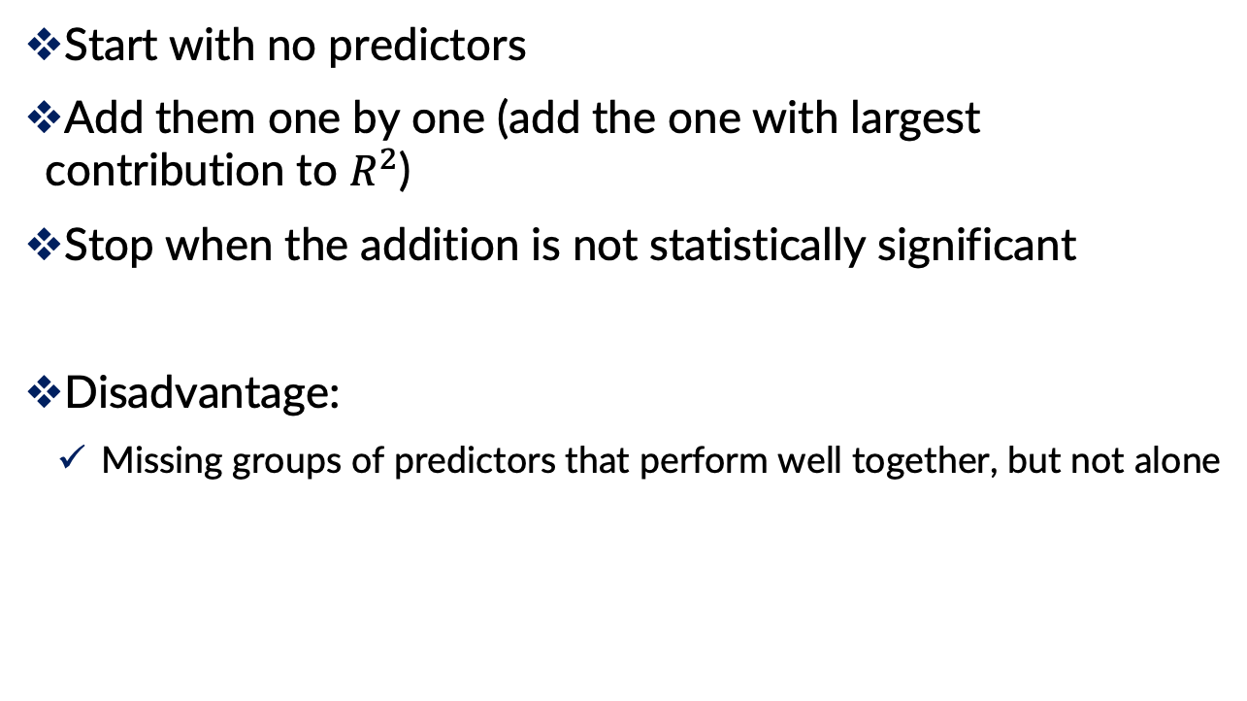
Forward Selection
Start with no predictors
Add them one by one (add the one with largest contribution to $R^{2}$)
Stop when the addition is not statistically significant
Disadvantage:
Missing groups of predictors that perform well together, but not alone

Slide 31
Backward Elimination
Start with all predictors
Successively eliminate least useful predictors one by one
Stop when all remaining predictors have statistically significant contribution
Disadvantage:
Computing the initial model with all predictors can be time-consuming & unstable

Slide 32
Stepwise Regression
Combination of forward selection and backward elimination
Like forward selection
Except at each step, also consider dropping non-significant predictors

Slide 33
Next step
Subset selection methods give candidate models that might be “good models”
Do not guarantee that “best” model is indeed best
Also, “best” model can still have insufficient predictive accuracy
Must run the candidates and assess predictive accuracy

Slide 34
Regularization (Shrinkage)
Alternative to subset selection
Rather than binary decisions on including variables, penalize coefficient magnitudes
This has the effect of “shrinking” coefficients, and reducing variance
Predictors with coefficients that shrink to zero are effectively dropped
Variance reduction improves prediction performance
In other words, this technique discourages learning a more complex or flexible model, to avoid the risk of overfitting

Slide 35
Regularization (Shrinkage)
Using a penalty
Ridge Regression: the normalization term is the sum of the squared weights (L2-norm)
Lasso: the normalization term is the sum of the absolute values of weights (L1-norm)
Predictors need to standardized to have the same scale

Slide 36

Ridge Regression
Linear regression minimizes Residual Sum of Squares (RSS)
The coefficients are chosen, such that they minimize this
This will adjust the coefficients based on your training data
But it does not work well if there is noise in the training data, then the estimated coefficients won’t generalize well to the future data
If we have highly correlated variables
This is where regularization comes in and shrinks or regularizes these learned estimates towards zero

Slide 37
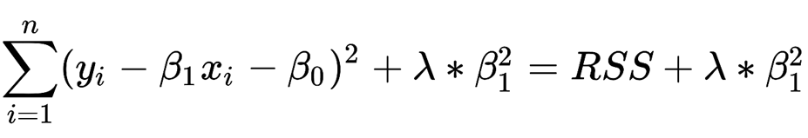
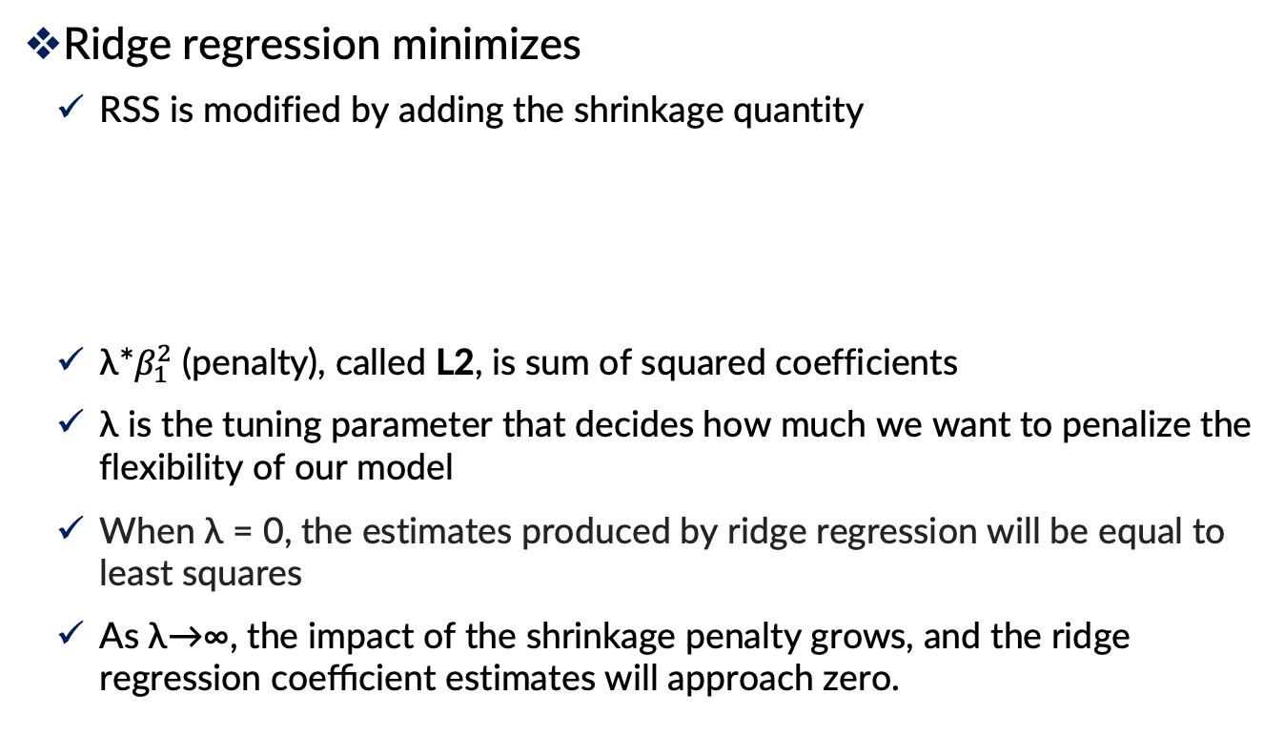
Ridge Regression
Ridge regression minimizes
RSS is modified by adding the shrinkage quantity
λ*$β_{1}^{2}$ (penalty), called L2, is sum of squared coefficients
λ is the tuning parameter that decides how much we want to penalize the flexibility of our model
When λ = 0, the estimates produced by ridge regression will be equal to least squares
As λ→∞, the impact of the shrinkage penalty grows, and the ridge regression coeﬃcient estimates will approach zero.

Slide 38
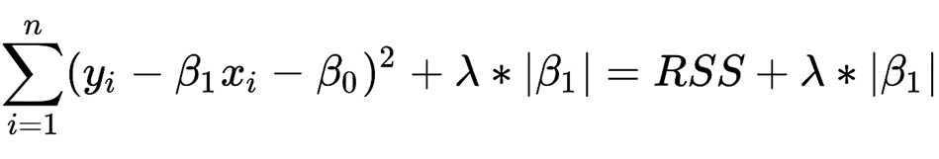
Lasso
Ridge regression minimizes:
Lasso regression minimizes:
The term λ|β1| is a shrinkage penalty, L1, which minimizing the sum of the absolute differences between the target value and the estimated values

Slide 39
Summary
Linear regression models are very popular tools, not only for explanatory modeling, but also for prediction
A good predictive model has high predictive accuracy (to a useful practical level)
Predictive models are fit to training data, and predictive accuracy is evaluated on a separate validation data set
Removing redundant predictors is key to achieving predictive accuracy and robustness
Subset selection methods help find “good” candidate models. These should then be run and assessed.

Slide 40


